Slide 1






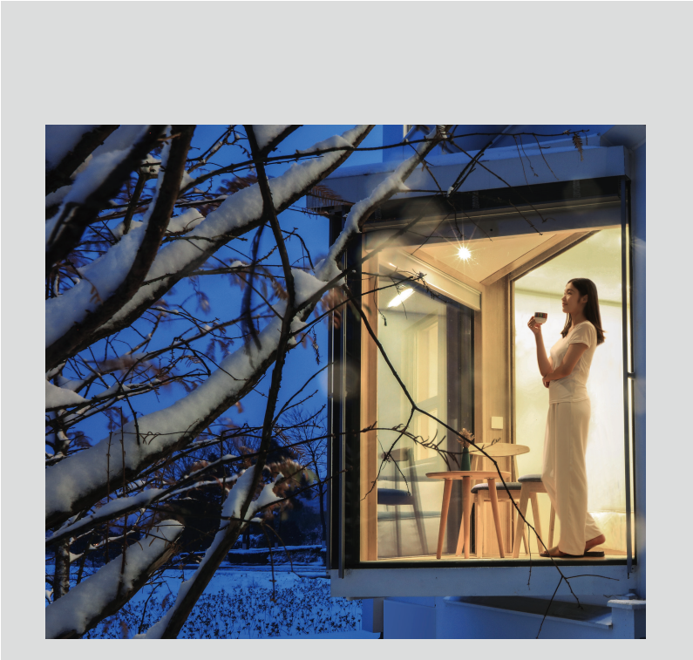

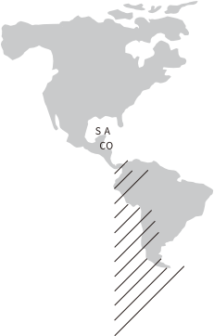
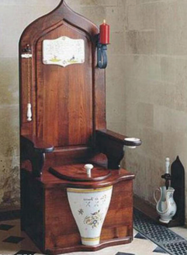
BSB Town, Xiangyin, Hunan Province Tel: 86-731-84086266
www.broad.com
100g
To protect forest & water
sources, please imitate us to
adopt compact layout & thin
paper printing
2022.09 The first edition
Quantity: 10,000
BY329-22©2022
About Holon Building
& Human Evolution
In 1590, Englishman Sir J. Harrington invented the world's first flush toilet, humans evolve from the lifestyle. In 2020, BROAD invented the world's first stainless steel factory-made "Holon Building", which may evolve humans from life attitude
If a person checked in a Holon building, he would feel comfortable, quiet and clean every day, which is different from other housing. After a long time, he would have found that the housing was the same inside and outside, as he had never encountered a malfunction. After that, he would no longer stay in or even look at other dirty or flashy housing, and would become picky about things other than housing. -- the person's attitude towards life has changed. If thousands of people, hundred millions of people had lived in Holon buildings, there would have been a population change, and then humans would evolve
The flush toilet
invented by Sir J.
Harrington
BROAD Global Market
(up till 2021)
2022.09 EN

Slide 2
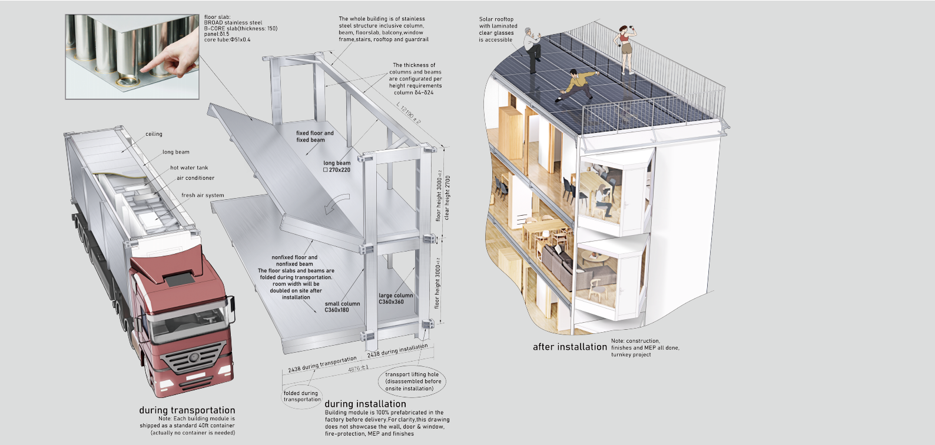

Holon Building's improvement to building assets: makes human assets a generational legacy
The future of 1000 years at the cost of 13-year R&D inputs
Holon building is a "stainless steel factory- made building" that BROAD Group has invested RMB 8+ billion & 1000+ employees for 13 years. The floor
slab is made of BROAD's original "stainless steel B-Core slab", and the columns and beams are made of section stainless steel. It is the world's first stainless steel building . Thanks to the "super-strong and ultra- light" characteristics of stainless steel B- Core slabs which can cut steel consumption drastically, what's more, the efficient s tr e amlined pr oduc tion c an convert expensive stainless steel buildings into economically acceptable ones. Importantly, the life span of a Holon building structure can reach 1,000 years. Even if it were demolished, the steel could be recycled, making it possible to become a generational legacy
content
Improvement to building assets 1
Improvement to the building industry 3
Improvement to householder's psychology 5
Improvement to householder's physiology 7
Improvement to householder's benefits 9
Standard apartment type:
Plate Housing A4.5 11
Standard apartment type:
Plate public building A4.5 13
Standard apartment: Tower B9 15
The Nature of Industry: Standardization 17
Only standardization leads to
streamlined production 19
Only standardization leads to
global transportation 21
Only standardization leads to
efficient installation 22
Rated parameters,
material parameters, technical standards 23
Brief History of BROAD
Factory-made Buildings 25
Company Profile 26
1 2

Slide 3
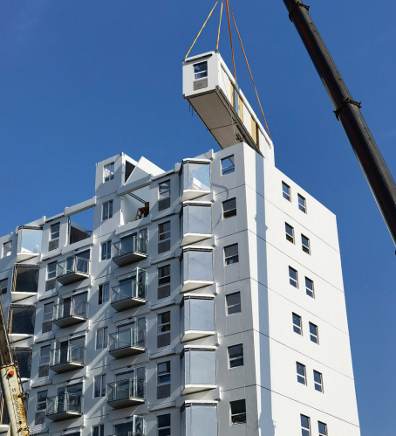


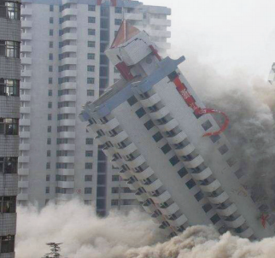
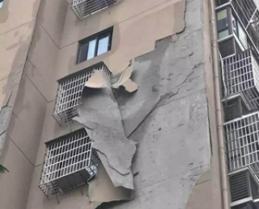
Holon Building's improvement to the building industry: making the complicated disorder controllable
Holon
VS
Traditonal
Factory made
Quality is assured; zero pollution during construction;
short construction time , 3F/ day
Stainless steel
1000-year life span, a generational legacy recyclable after disposal.
Ductile materials, strong earthquake resistance
Flexible
Large space of non-load bearing structure (11.7x4.8m), walls,
doors and windows can be removed or revised after completion
More comfort, lower consumption
"Nearly Zero Energy Building Standard" and "Passive House Standard" are adopted for
90% higher energy efficiency (A/C noise level reduced by 90%)
100 times cleaner than outdoors
When the BROAD Fresh Air Machine is used, 100% fresh air is brought in from the outside, filtering PM2.5 by 99.9%
Complete isolation
4-paned glass windows, 22cm rock wool for exterior walls.
Ventilation through fresh air machine isolates outdoor noise
Site work
Hard to control quality; heavy construction pollution ; Long construction period; the delivery time is hard to control
Reinforced concrete
50-year life span,waste family assets and human resources, The earth is stuffed with construction wastes after buildings are disposed of. Brittle materials, buildings collapse easily in case of earthquakes
Fixed
Limited space of non bearing structure (The length and width: generally less than 4m) no alteration allowed after walls, doors and windows are completed
Less comfort, higher energy consumption
Poor thermal insulated exterior wall,
A/C high energy consumption, very noisy
Method
Structure
Space
Comfort &
energy efficiency
Air quality
Outdoor noise
Air can be worse than outdoor air
Normal ventilation by windows,
When A/C is on, windows are usually closed, indoor air quality is poor
Transfer into building
Poor sound isolation of windows, Ventilation by windows can't isolate the indoor noise from outside noise
5-Controllable Building
Structures, decorations and MEP are 100% factory-made. The only procedure to be conducted on site is bolt connection. 3 floors/day. Holon building is the world's first "5 C building": quality controllable, construction time controllable, cost controllable, CO₂ controllable and global transport controllable
3 4

Slide 4

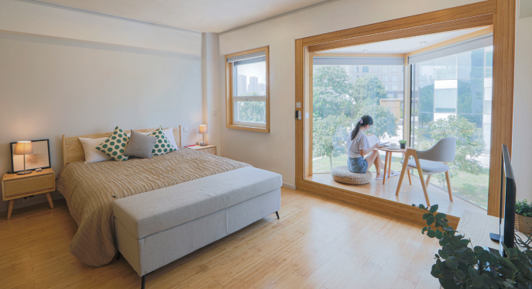
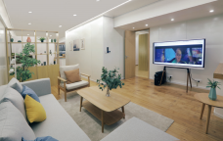
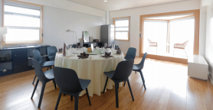
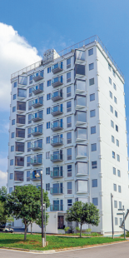
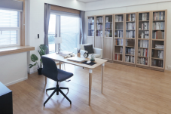
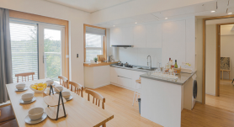
Holon Building's improvement to householder's psychology:Free space shapes free thoughts
Psychological factors and key improvement programs:
1. Space comfort - Column-free space is huge, flexible room layout
2. View comfort - Ultra clear glasses ensure perfect outdoor views
3. Sunlight comfort - Long sunshine time, interior and exterior shades control lighting at random
4. Furnishing aesthetics - Wall PE baking paint, color last for decades
5. Switch comfort - Auto- power generated wireless switch, room layout is convenient
1 Space comfort standard 1) Big interior space:Room clearance 11.7m x 4.8m, rooms can be configured at random except the location of the bathroom drain pipe, it is much larger than any residential building in the world without columns or no bearing walls 2) The indoor clearance is extremely high: Apart from the bathroom area for setting fresh air, A/C, hot water, electric fittings and with a suspended ceiling, other spaces are 2.7m high flat ceiling. Ceiling with beams, lamps and cables and a variety of sensors, fire sprinklers can also be equipped if needed. As Holon Building R & D was developed as deep as a large passenger plane, the 3m floor height, with floor slab, ceilings to ensure sound insulation, extremely complicated MEP, which is astonishing to free up 2.7m of clear height 3) Very high space utilization efficiency: Due to the steel structure and in- depth research and development, the load-bearing structure occupies less than 1% of the space, space utilization efficiency is 3-6% higher than that of traditional concrete buildings. 2 View comfort standard 1) Casement window & bay window 2.57 x 2.4m, bay window with 180 degrees view 2) All windows are of ultra clear glasses, 4-paned glasses are more clear than 1-paned glass, colorless, can ensure the original good views outside 3) Window glass is very airtight hollow glass, argon charging ≥92% to ensure no fogging 3 Sunlight comfort standard 1) Super clear glass for all windows, the sun does not change color or get weak when it shines into rooms 2) The sun shines into a bay window from sunrise to sunset, increasing the sunlight duration significantly. In winter, the building can absorb a lot of sunlight to save energy 3) Exterior sunshades can be put up and down freely & adjustably per the sunlight 4) The interior shade is able to block more than 99% of light, when you sleep in the daytime you would feel as if it were at night 4 Furnishing aesthetics standard 1) PE painted wall and ceiling will not change color for decades. The paint surface is dirt-proof and wear-resistant, can be wiped and washed 2) Floor, door and window cover and door page are made of original bamboo material, beautiful and strong | 5 Switch comfort standard 1) All lights and shade switches are wireless and can be positioned at the convenience of occupants anywhere 2) When a room is vacant, the light, A/C, and fresh air will be off automatically within 1 hour 3) Stair lights, entrance lights and night lights are automatic 4) The A/C and fresh air will be automatically off after opening windows or balcony doors within 30 minutes 5) Each room is equipped with WiFi-reliable network signal, and TV set can be set anywhere 6 Touch comfort standard 1) All switches, buttons and handles are ergonomically designed 2) All parts touched are smooth and will not scratch hands 3) Door and window opening/shutting strength is appropriate, not too heavy or too light 7 Lamplight comfort standard 1) Light color temperature 3100±100k (slightly warm and pleasant) 2) 3 to 5 lighting switches for each room with room lightness adjustable 3) Toilets are installed with low-positioned night lights 8 Socket convenience standard 1) Each room is equipped with 2~5 power sockets to fully meet the needs of electric charging, table lamp, TV and kitchen electricity 2) If rooms are changed, more sockets are needed, wires can be dragged out from the baseboard to add more sockets 9 Finely crafted interior decor standard 1) Thanks to streamlined production of interior and exterior decoration, the fineness of decoration is guaranteed by equipment and quality system, which makes the decoration bid farewell to the stubborn disputing disease of traditional construction mode 2) The flatness and color difference of walls, floors, and ceilings are not visible with naked eyes. 3) All corners and edges are neatly and uniformly connected with an accuracy deviation < 1mm 4) Glue width of all joints 4±1mm, delicate and beautiful 10 Vibration isolation comfort 1) Floor slab vibration acceleration < 0.05 m/s² . No vibration from walking or movement. Each floor is an independent structural module that does not transfer vibration 2) Wind vibration acceleration < 0.2m/s², no feeling of building swing in case of gale
Notes: photos are real scenes of Holon building
5 6

Slide 5

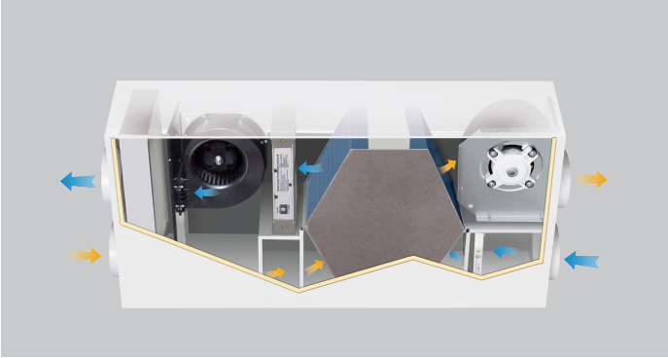
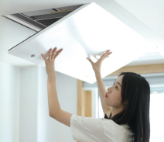
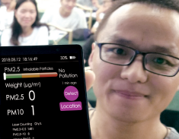
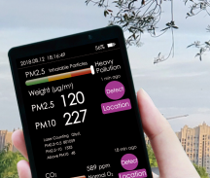
Holon Building's improvement to householder's physiology: Healthy air cultivates healthy bodies
Physiological impact factors and key improvement programs:
1. Air freshness - Sufficient fresh air (4m³/m² • h), and no mixed return air
2. Air cleanness - Fresh air filtration, indoor air 100 times cleaner than that outdoors
3. Airflow comfort - A/C airflow is reduced by 70%, air outlets avoid people
4. Thermal comfort - The building is thoroughly insulated to avoid cold radiation and thermal radiation
5. Bath comfort - Hot water comes out within 5 seconds, water distributor under constant pressure
6. Quietness comfort - With 4-paned soundproof windows, 90% A/C noise is reduced
The key to clean air technology in Holon Building is the use of "BROAD fresh air machine", which was invented in 2008 and has won wide acclaim worldwide
Coarse Filter
The filtration efficiency of PM10 is 70%
Clean Fresh Air Out
To the bedroom,
living room, office
Exhaust Air In
From the kitchen,
bathroom
Air Heat Exchanger
Heat recovery by 80%
Super Filter
The filtration efficiency of PM2.5 is 99.9%
Electrostatic Cleaner The filtration efficiency of PM0.3~10 is 98%
Exhaust Air Out Exhaust Outdoor
1 Air freshness standard 1) Fresh air 100% from outdoor to indoor with no mix of return air eliminates odor cross contamination, prevents virus infection 2) Fresh air volume ≥ 4m³ /m² • h to ensure an indoor CO₂ concentration level ≤ 900ppm 3) Each household can have an option:to buy a CO₂ sensor to monitor oxygen content in real time 4) Fresh air is sent into rooms with positive pressure, dirty air from outside and corridors can not get indoors through seams, no more worries of mosquito bites 5) After staying for a period, residents shall realize the beauty of life without opening windows. In most cases, compared with opening windows, the indoor air would be fresher when windows are closed, as the fresh air machine supplies fresh air 24/7, ensuring more natural ventilation than window opening 2 Air cleanness standard 1) BROAD fresh air machine is used, which filters PM2.5 by 99.9%, achieving the following: a. Indoor air is 100 times cleaner than that outdoors, enhancing human health drastically b. Desks can be dust-free, avoiding cleaning for 1 month, and finishes for walls and ceilings look like new for decades c. As the fresh air is filtered, fresh air outlet is 1000 times cleaner, ensuring clean indoor air and the pipes, A/C and the fresh air machine do not collect dust or breed bacteria 2) The fresh air machine is equipped with an electrostatic cleaner for disinfection and sterilization, so that outdoor viruses and pollen will not enter rooms, while ensuring indoor ozone level lower than outdoors 3) Fresh air is sent into rooms and vented from bathrooms and kitchens.The bathrooms and kitchens will always maintain a negative pressure so that unpleasant moisture and odors will not drift into rooms 4) Each drainage outlet in bathrooms and kitchens is equipped with a water seal ≥ 50mm. It will not be dry in 10 days, ensuring no air return no unpleasant odor and no contagious virus 5) The joints between bamboo floors are filled with sealant, no dirt at all 6) Decorative materials and glue in line with European E1, China E0 standards, no formaldehyde and other harmful substances 7) The super insulation performance of the exterior walls and windows guarantee no condensation and no mildew breeding 8) Water and electricity holes between floors and between each household are fully blocked to prevent rats, cockroaches and ants from entering rooms 9) Range hood equipped with glass cover, eliminating lampblack to spread by 90% 10) Each household can have an option: to buy a PM2.5 detector which detects indoor and outdoor PM2.5 level within 30 seconds 3 Airflow comfort standard 1) Outlet of A/C, fresh air need to avoid blowing directly towards the place where people frequently stay 2) Airflow of A/C can be cut 70% min thanks to the A/C load less than 90% load and no more dry skin | 4 Thermal comfort standard 1) High thermal insulation (22cm rock wool for exterior wall insulation, which is equivalent to 9m thick concrete wall),4-paned windows, in summer no heat radiation, no worries of a western sunshine exposure, in winter no cold radiation 2) When the sun shines into rooms in summer, the sunshade will go down automatically 3) When there is no one in rooms in cold or hot season, or when people are sleeping, the interior shade will go down automatically(the interior shade is equivalent to a concrete wall of 2m thick) 4) The fresh air machine is equipped with a hi-efficiency heat exchanger, which can recover 80% of exhaust heat. The temp difference between the fresh air and the room temp is around 2 °C 5) Every household is equipped with an A/C, adjusting temperature as desired 5 Bath comfort standard 1) Every household is with independent hot water system, hot water supply 24/7 2) Hot water comes out within 5 seconds from all hot water faucets， which removes waiting worries 3) The pressure of hot and cold water has the same origin, and the temperature does not fluctuate while turning on a faucet in neighboring rooms 6 Quietness comfort standards 1) Completely isolate outdoor noise ( much higher than Chinese National Standard) a. Double steel plates and 22 cm rock wool for exterior walls. Sound level 50dB b. 4-paned windows. 3-layer sealing strips for windows, balcony doors and entrance door. Sound level 40dB, when interior shade is down, sound level 45dB 2) 2 steel plates and 7.5 cm rock wool for interior walls. 35dB for rooms and 50dB between households 3) 2 steel plates and 15cm rock wool for floor slabs, with 3.75cm ceiling below floor slab, sound level 55dB 4) All seams around walls, windows and floor slabs are sealed with silicon adhesives on both sides. Photos should be taken for hidden glued places for the ceiling decoration strips and baseboards to ensure that the installation quality meets the design standard 5) A/C and fresh air machine are installed away from the bedrooms to avoid interfering with sleep 6) Minimal A/C load, accounts for 10% traditional buildings, 90% noise reduction 7) Drain pipes are separated by 2 steel plates and 5cm rock wool partition walls. No noise is heard in bedrooms 8) Room lock is equipped with cushioning rubber mat, opening and closing sound is minimal
Fresh Air In From Outdoor
Air Supply Fan
Power saving, quietness design
Exhaust Air Fan
Power saving, quietness design
Fresh Air Machine is on ceiling-mounted, and it only takes one minute to open the cover, remove and wash the filter
Indoor PM2.5
Outdoor PM2.5
Why do Holon Buildings have strict comfort standards?
People spend 90% of their life inside buildings, and the quality of buildings determines their mental and physical health. Therefore, the Holon building sets 16 strict comfort standards (which can be written into the purchase contract), so that the residents, including the rich and the poor, can enjoy the high quality of living life. Unfortunately, traditional buildings cannot meet these standards, no matter in design, materials, construction, or cost, they are out of reach. Not that BROAD Group is much better, but cars from streamlined production is 100 times better than hand- made cars
7 8

Slide 6
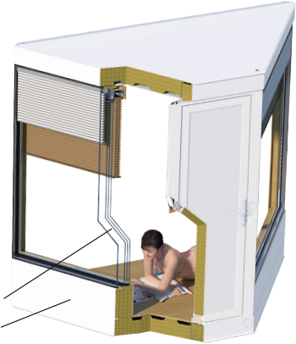

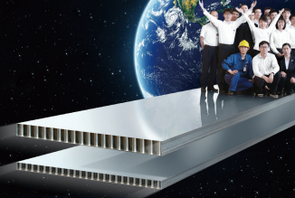

Holon building's improvement to householder's benefits: One time investment, everlasting benefit
Benefit related factors and key improvement solutions:
1. Operational energy saving - Nearly zero energy building standard, ultra thermal insulation, 90% higher energy efficiency
2. Asset's value maintained - Complete stainless steel structure, value like gold and silver jewelry can be maintained
3. Easy Maintenance - The exterior wall uses wash-free fluorocarbon paint. All concealed work can be accessible
4. Easy to change: Walls, doors, windows & balconies can be easily moved. A whole building can be moved
5. Safe use: A steel structure is super strong earthquake resistance. A building external fire escape ladder doubles fire prevention
Holon building
structure is 100%
stainless steel,
leaving precious
assets for future
generations
1 Operational energy saving
1) Holon building is designed, produced, accepted and operated per"Nearly Zero Energy Building Standard" GB/T 51350-2019 and German "Passive House Standard" (Version 10A). It is the most energy efficient building except the one with renewable energies
2) Holon building mainly adopts 5 thermal insulation measures: 22cm rock wool for exterior walls, 4-paned glass windows, exterior shade and interior shade, fresh air heat recovery, 90% less energy consumption than that of conventional buildings
3) For example, a 68m² Holon building for a family of three in Shanghai can save 6915 kWh/year compared with traditional buildings (per the following "Energy Efficiency Calculations")
4) In addition, solar panels are also used on rooftop. The renewable energy obtained is not calculated within the above energy-saving indicators. For areas rich in solar energy resources, solar power generation may be more than the power consumption of the Holon building, it becomes a zero or negative energy consumption building.
2 Assets value maintained
1) Holon building is of stainless steel structure inclusive column, beam, floor slab, balcony, window frame, stairs, roof and guardrail. It enjoys a 1000 year life design. Building depreciation cost is extremely low. Construction materials can be 100% recycled even if a building is scrapped ahead of schedule. Therefore, Holon building can be a generational legacy--It's better to have Holon building than to deposit gold and silver jewelry
2) Exterior wall uses galvalume slab and fluorocarbon paint, wall seams are glued with silicon weather-resistant sealant. The Empire State Building has been in use for 90 years and is still intact
3) Interior wall is made of galvalume slab and PE paint, life design is 100 years
4) Water supply pipes are of stainless steel, extremely durable
3 Easy maintenance
1) Exterior walls use fluorocarbon paint, and fluorine is non-stick dirt resisting material. The exterior wall will not be dirty even no wall washing for 10 years
2) Fresh air machine and A/C can be easily opened and filters inside can be easily cleaned
3) Easy access door for electric facilities and pipeline maintenance
4) Holon building is 100% factory-made, only bolt connection and seam gluing of walls are required on site. Eliminating quality defects caused by negligence of on-site inspection management
5) Hanger rod around roofs, which can hang 1200kg hanging basket. It is convenient for the maintenance and reconstruction of facades (such as adding balconies)
6) Maintenance manual is complete and clear. Make maintenance easier
4 Easy to change
As a long-cycle facility, it is essential for buildings to change its functions
1) All interior and exterior walls are non-load bearing walls. After construction is completed, walls, doors and even the windows can be easily moved if needed
2) The position and dimension of balcony and bay window can be changed after construction is completed. If necessary, rooms with depth ≤ 4m, large balcony, swimming pool or botanic garden can be inserted into the building(The load shall be calculated by the structural engineer if the added load is over 20t)
3) Floor slab is made of BROAD's stainless steel B-CORE slab with no concrete at all. The slabs are easily sliced or drilled for adding kitchen and bath pipelines, stairs and elevators. If necessary, the whole floor slab can be removed for retrofitting to a duplex. (A structural engineer needs to do the stability calculation if it's a high rise)
4) Exterior and interior walls use steel plate paint with adhesion 2Mpa strength. Finishing such as wall papers, ceramic tiles and marbles can be applied easily
5) Closets, TVs and furnishings ≤20kg/m² and can be easily pasted or mounted(by nails)
6) Wood floor, ceramic tile and marble can be applied to the floor slab
7) Storeys can be added to low-rise buildings (The basic structure of Holon buildings can be built up to 12 floors, it needs to be multi-layer stacked and resist wave swaying during sea transport.)
8) If needed, the whole building can be disassembled and rebuilt in another location(Achieve nondestructive disassembly and reassembly)
5 Safety in use
1) Complete stainless steel structure with high ductility. Reinforced concrete elongation is nearly zero, whereas stainless steel ≥ 20%. No matter how strong the earthquake, Holon structure can deform, but will never collapse
2) To meet official fire code regulations, each floor is equipped with a building external fire escape ladder, which is more effective than any other fire protection measures to ensure safety
3) Bathrooms are equipped with anti-slip PVC floors, protecting the old against slips and falls
4) Balconies, handrails and windows are designed to prevent children from climbing
5) Stainless steel is a good conductor. If a lightning strike happens, it goes directly from the column to the ground without affecting the building occupants
6) The power supply is equipped with a leakage protector to prevent electric shock
7) Exterior walls are made of double-layer steel plates, which isolates the ubiquitous electromagnetic radiation outdoors
8) All edges of windows and door frames, window hinges, sanitary fittings and mirrors are smooth, preventing scrapes
9) It will alarm automatically when windows are forgotten to be closed on rainy days or toilets overflow
The world's most stringent thermal insulation measures are adopted for Holon buildings
exterior shade
interior shade
^{(take} ^{the} ^{bay} ^{window} ^{as} ^{an} ^{example)} 4-paned glass windows
(ultra-clear glass )
22cm rock wool for exterior walls ( δ 0.7 galvalume steel plate sandwiched with rock wool)
Energy Efficiency Calculations For example, a household with a building area of 135m²
A building external fire escape ladder ensures safety more effectively
Under the premise of meeting the official fire regulations, Holon building is equipped with a "building external fire escape ladder" on each floor, which is more effective than
any other fire protection measures to protect the safety of residents
According to the statistics of fire cases in countries around the world for decades, more than 2/3 of the burning buildings and stairwells are blocked by toxic smoke
According to decades of experience in the United States and Japan, the use of escape ladders or escape ropes outside the building is the most effective measure to ensure a successful escape
Climate zone |  |  |  | Severe Harbin, Moscow | cold | Cold Beijing, New York, Tokyo |  | Hot summer & cold winter Shanghai, Changsha, Rome |  | Hot summer & warm winter Guangzhou, Taipei, Dubai | Warm Kunming, Sydney,Nairobi
Heating & cooling demand | Item Exterior wall Window Fresh air Lighting Personnel Electrical Total | Parameter |  | summer 17 65 70 59 84 124 419 | winter 1443 622 554 -110 -99 -204 2205 | summer winter |  | summer 167 1431 669 200 296 423 3186 | winter 685 244 185 -62 -68 -135 851 | summer 277 2443 355 578 416 797 4867 | summer 2 135 23 52 39 74 324 | winter 359 35 13.6 -15 -13 29 351
 |  | 66m² 36m² 200m³ 100W 500W 600W kWh/a | K=0.2W/m² K K=1.4W/m² K 80% heat recovery LED 3.3W/m² /5 people Including kitchen and home appliances |  |  | 92 986 225 128 187 271 1890 | 1074 546 319 -92 -91 -191 1566
Heating & cooling demand / m² |  | kWh/m²a |  | 3.1 | 16.3 | 14 | 11.6 | 23.6 | 6.3 | 35.9 | 2.4 2.6
A/C | Total | kWh/a |  | 1361 |  | 1395 |  | 1299 |  | 1568 | 202
power cons. | Annual average | kWh/m²a |  | 10.1 |  | 10.3 |  | 9.6 |  | 11.6 | 1.5
Fresh air power cons. | Total Annual average | kWh/a kWh/m²a |  | 235 1.7
Total annual |  | kWh/a |  | 1596 |  | 1630 |  | 1534 |  | 1803 | 437
Annual / m² |  | kWh/m²a |  | 11.8 |  | 12.0 |  | 11.3 |  | 13.3 | 3.2
Equivalent to primary energy |  | kWh/m²a |  | 30.6 |  | 31.3 |  | 29.4 |  | 34.6 | 8.3
Note:
Holon building is designed, produced, accepted and operated per "Nearly Zero Energy Building Standard" GB/T 51350-2019 and German "Passive House Standard" (Version 10A). This standard is 90% more energy efficient than that of conventional buildings. An energy saving example of a household: 135m²/ apartment in areas with hot summers and cold winters) in Holon Building, annual electricity saving: 13830 kWh, CO₂ reduction by 11894kg yearly. Assuming that one tree absorbs 18.3kg CO₂ emissions yearly, it equals to planting 650 trees.
9 10

Slide 7
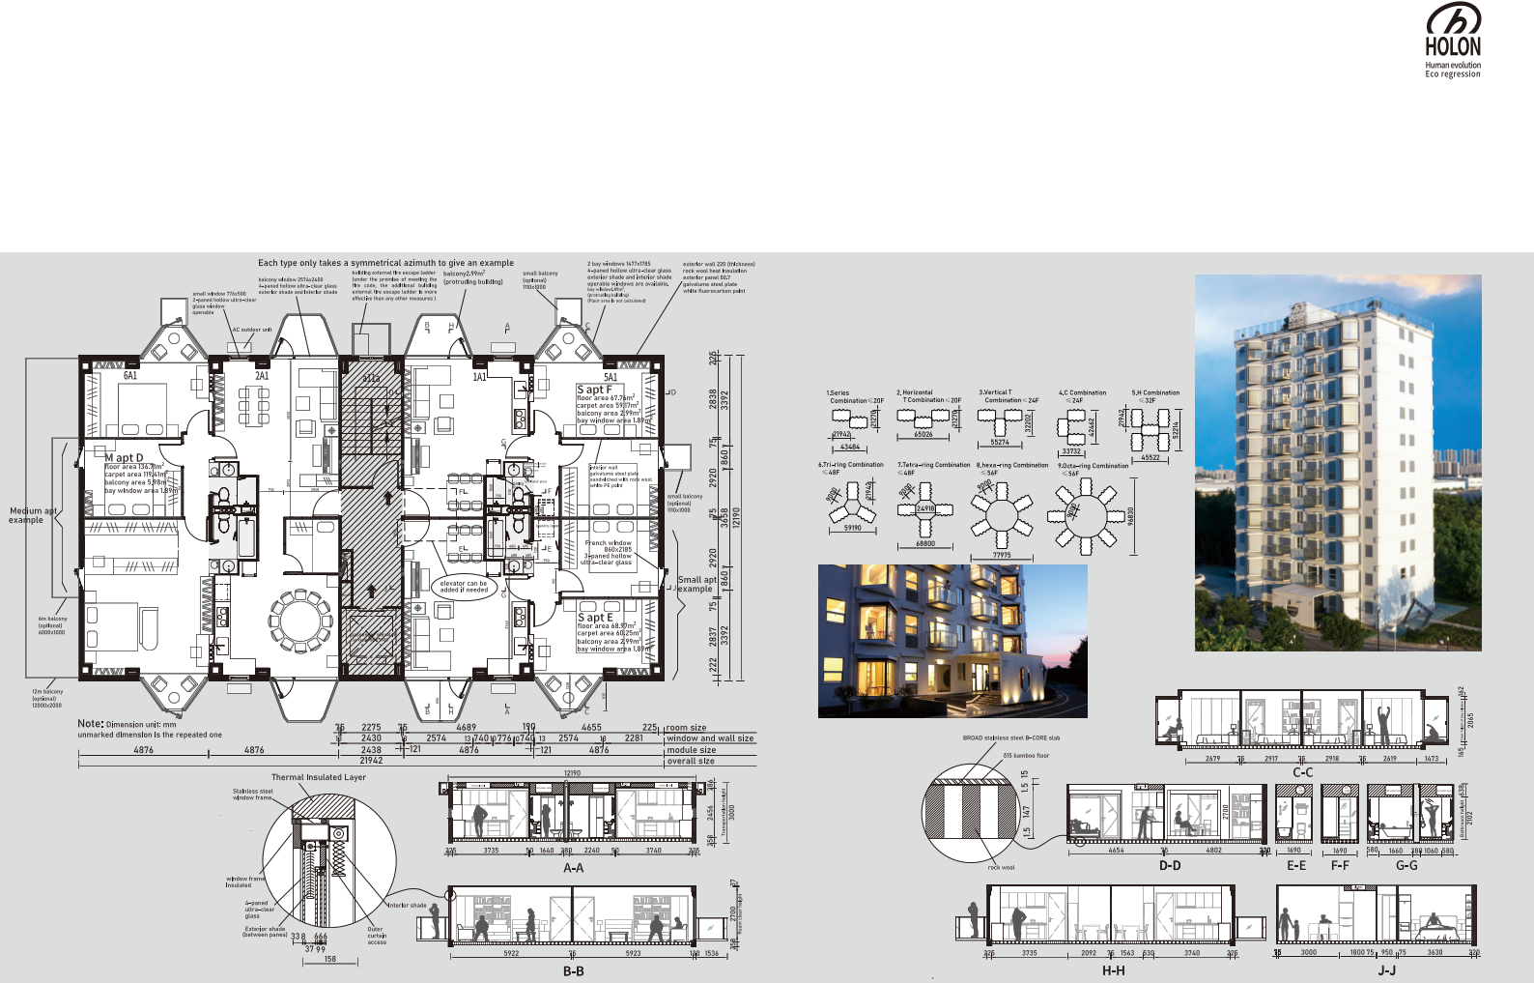
Standard building models:
Plate Housing A4.5
268m²/F (without calculating bay window and balcony) Version 15.0,same as below
Plate Housing A4.5 Features
1) Small size, extremely convenient room layout. Fewer households on each floor, less interference. Small column and thin wall make higher space utilization efficiency
2) Daylight design is convenient thanks to bay windows, buildings can be configured from any angle, every household enjoys the sunshine
3) Disadvantages:Too small to build tall buildings (unless the combination of multiple buildings)
4) Floor numbers: 10-16 floors are recommended (30m-48m). Buildings lower than 10 floors are less economical, and under 6 floors are not economical at all
A4.5 Combination Examples
Notes: photos are real scenes of Holon building
Small Apartment Cross-section
11 12

Slide 8
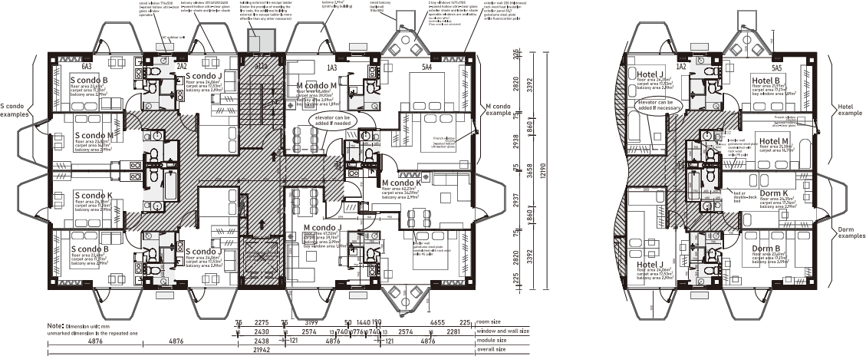
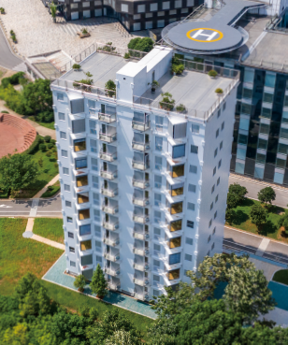
Standard building models: Plate public building A4.5
268m²/F (without calculating bay window and balcony)
Notes: photos are real scenes of Holon building
Windowless Kitchen & Bath
1) It is a common practice in developed countries nowadays to set kitchen and bathroom in dark areas and leave limited lighting areas for living room and bedroom. If windows in a kitchen and bathroom are opened for ventilation, its dirty air will blow into the living room and bedroom. It was the unhealthy and outdated method before mechanical ventilation was invented
2) BROAD Fresh Air Machine is used in Holon building with 80% heat recovery and 99.9% filtration of PM2.5，supplying 100% fresh air in living rooms and bedrooms 24/7/365. Dirty air is expelled from kitchens and bathrooms to keep the bathrooms dry and make indoor air healthy with a good smell. Fresh air is sent into the bedrooms and living areas while dirty air is vented from bathrooms. This is a standard procedure in all 5-star hotels worldwide. Additionally, 100% fresh air system with windows closed is required by European "Passive House" and China’s "Technical Standard for Nearly Zero Energy Building", which is healthy, saves energy and insulates noise, is the trend of future architecture
3) Holon Building can have a kitchen besides the window to use gas, but we recommend electricity. It is stipulated in many countries that natural gas should not be used if the kitchen is windowless. China’s 14th Five-Year Plan for green buildings mandates the use of electricity for cooking and household hot water instead of gas. It makes sense, for it is impossible that the gas stoves and pipings never fail with human faults in decades. As people are used to keeping the
windows closed in cold days, any tiny gas leakage is prone to an explosion. If an explosion takes place, steel structured buildings may get deformed and reinforced concrete buildings may collapse. Collapse tragedies and deaths take place everyday all over the world which is a threatthat should not exist in modern society
4) In recent years,great progress on the electric stove technology has been made in many countries.Many 2kW electric stoves can reach the fire intensity of a gas stove. It’s not a problem at all even Chinese are used to cooking with hign fire. Some good electric stoves can be recommended. Advantages of replacing gas with electricity ①safe ②Healthy. No carbon monoxide, nitrogen oxides, heavy metals and other carcinogens ③ Clean: less smoke stains in the kitchen and utensils
5) External and internal walls and windows and sanitary fittings are all standard Holon Building supplies. Cabinets are optional. Clients can purchase by themselves, The illustration is recommended for your reference. BROAD suggests an open kitchen design for convenient use. Some people are concerned that the oily smoke in an open kitchen will diffuse into the room. BROAD has devised a smart solution: add a U-shape glass cover beneath the range hood, which does not obstruct cooking but reduces the smoke by 90%+. People are no longer choked, and the room is no longer smoky
6) Many things in life we get used to must be changed, most notably air quality and safety, which is closely related to everyone
Standard Housing Selection Keys
1) Combination:
Standard building models include small, medium and large apartment, condo, hotel, dorm. One, two or a variety of unit layouts can be set up on one storey or in the whole building, as long as the location of the tube well remains unchanged. Please refer to "Building Model Overview" for specifications
2) Functions:
①Electromechanical equipment: AC, fresh air and hot water system are ceiling- mounted in every household. Independent metering, and online payment available
②Kitchen: Lampblack pipe, water supply, hot water and drainage are equipped in each household. Kitchen can be placed anywhere near the bathroom
③Bathroom: Sanitary fittings, water supply, hot water and drainage are equipped. Toilet position cannot be changed, but other parts can be designed freely according to different needs
④Room: Standard configuration of interior walls and doors is shown in the drawing, which can be adjusted per clients’needs ( interior walls and doors can be adjusted inside the module of 11.7×4.8m)
⑤Windows and balconies: Standard configuration is shown in the drawing. If users want to change the balcony into bay window (or vice versa), needs shall be proposed in advance(modification cost is higher afterwards)
3) Constraints：
To meet the need of factory production, the sizes and positions of the following parts are unchangeable:
①Wells ②lampblack well ③bathroom ④staircase and fire passage
⑤exterior wall, window ⑥column fire protection layer ⑦Kitchen is near the bathroom, which is convenient for connecting the lampblack and water pipes
4) Extensions:
①Except 3, other internal walls and doors can be changed if needed
②The standard color of the exterior wall is white, which can be changed if the customer needs, with significantly prolonged construction period and increased cost
③Multiple buildings can be combined to reduce occupied area, improving lateral load resistance to build higher buildings, which is applicable to the country extremely lack of lands and buildings
④As Holon Buildings weigh about 10 times lighter than reinforced concrete buildings, the requirements on foundation strength is greatly reduced, and Holon Buildings can be built directly on the foundation after old buildings are dismantled (load calculation is required)
5) Standard models are highly recommended:
The standard building model is the result of our thorough market investigation and in-depth research and development. It is the biggest common divisor of the conflict between the "standardization" of comprehensive industrial production and the "diversification" of customer demand. Therefore, it is recommended to use the standard model as shown in the picture directly. Any small changes will greatly increase production and management costs, complicate the troubles in drawing review, construction application and quality risk, and greatly extend the cycle of design, procurement, production, installation, construction application and make the maintenance complicated. On the other hand, it is not difficult to change the position of internal wall and doors, add or reduce room numbers during installation or finished
13 14

Slide 9
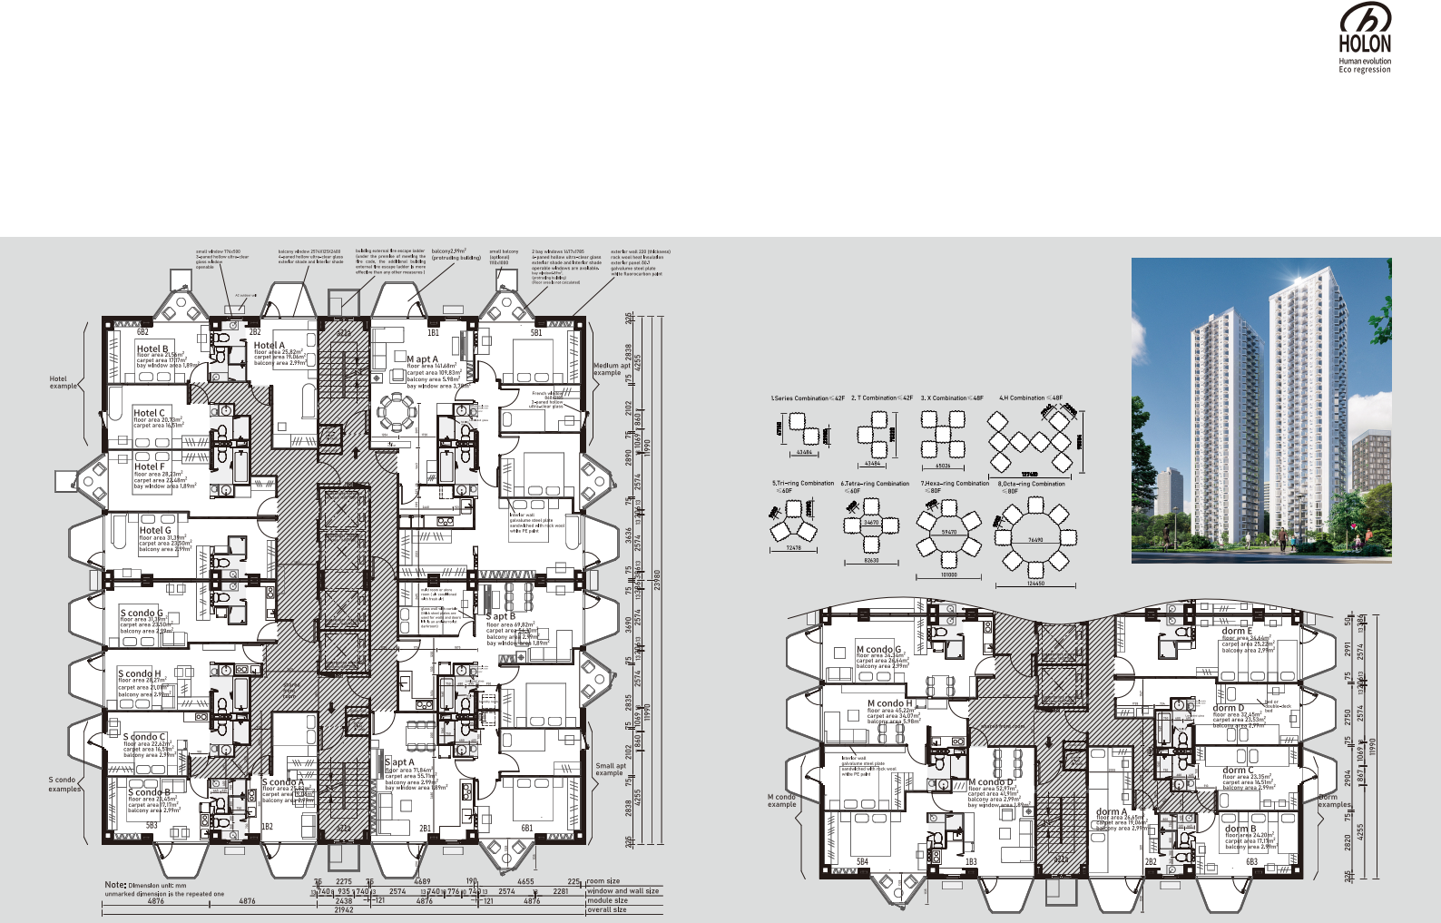
Standard building models:
Tower building B9
526m²/F (without calculating bay window and balcony)
Tower B9 Features
1) With a square shape, tower-type occupies small areas, large shaped, which is suitable for high-rise buildings. Extremely high space utilization efficiency
2) Sufficient elevator numbers with short waiting time. Elevator configuration: ≥ 24F 4 elevators, ≥ 16F 3 elevators, ≥ 12F 2 elevators
3) Daylight design is convenient thanks to bay windows, buildings can be configured from any angle, every household enjoys the sunshine
4) Disadvantage: large shaped with a small part of dark area
5) Floor Numbers: 20-32 floors are recommended (60-69m). Buildings lower than 20 floors are less economical and under 10 floors are not economical at all
B9 Combination Examples
15 16

Slide 10

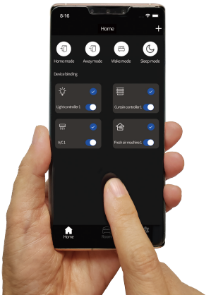

The essence of industry: Standardization
Only through standardization，it can be possible for the general public to live in high quality buildings. Make human life attitude evolve
The automobile industry is the most successful industry in modern times. The secret of its success lies in standardization: few varieties and large quantities. Holon building comprehensively draws on the experience
Only standardization can make it intelligent
In today's digital age, people have
put forward many demands to make buildings intelligent . Traditional building intelligent control system requires engineers to spend a lot of time on - sit e installa tion and debugging, and the cost is very high, so it is difficult to popularize
The "BBA intelligent control system" of the Holon Building fully meets the needs of users for convenience, comfort and energy conservation, and the cost is more than 10 times lower than that of the traditional intelligent c ontr ol sys t em of the building, because it is produced and tested on the standardized assembly line
of the automotive industry, implements the "Five Principles" of systematization of research and development,
generalization of parts, modularization of parts, automation of production and simplification of ordering, and creates standardized construction products with high quality and low price that "meet the fundamental needs of customers" to meet the needs of 70% of the world's middle-income people
• Low cost of raw materials
• Waste materials can not be recycled, serious pollution
• The reinforcement in the concrete is easy to rust and the building life is short (50 years legally)
CONCRETE BUILDING
• After completion, the room depth, external wall window
Many people without industrial experience, including architects, real estate developers and property buyers, believe that "prefabricated buildings" should be customized according to customer needs. However, the painful lessons of
prefabricated buildings all over the world in the
past 60 years tell us that if customized according to
customer needs, we can only carry out on-site
construction. If customers want to get perfect
and affordable housing, they must be produced
in the factory, and if they want to be produced
in the factory, they must be standardized.
This is like a customer customizing a car of
special size and shape to a car factory.
No clever manufacturer can do it unless
the customer pays expensive R & D
fees and mold fees
CAR
• Mature market and high consumer recognition
and balcony are ﬁxed
• The material is extremely heavy and brittle, with nearly zero elongation. A strong earthquake will collapse
• Can be designed in any size
• Relying on site construction, there are many quality loopholes
• The delivery quality and content are diﬃcult to be transparent and easy to dispute
• Pricing is complex and opaque, easy to dispute and
• Short life span(10-20 years)
• Few varieties and similar sizes
• Huge investment in R & D funds and time
• Various automation and information functions are available
• A product has to be tested rigorously before it can be ﬁnalized
• Sophisticated quality management process for incoming materials,manufacturing processes and outgoing product quality management process
• Large batch, streamlined production, extremely low labor cost
• "Volume for price "supply chain system, the material cost is greatly reduced
• Transparent price and delivery content
• A turnkey delivery leaves no hassles for customers, only one company to take the full responsibility, no buck-passing
• Few varieties, module size like a 40 ft container
• Stainless steel is 30 times more corrosion resistant than carbon steel,and its lifespan exceeds one thousand years. It can be recycled after being discarded
• Stainless steel structure with high ductility. Elongation≥ 20%. No matter how strong the earthquake, Holon will only be deformed, but will never collapse
• 90% less energy consumption than that of conventional buildings. Construction waste is almost zero
• Indoor air 100 times cleaner than that of outdoors
• 100% fresh air, no recycled air
• The number of ﬂoors can easily be increased/decreased
(up to 12 ﬂoors can be built using the base level structural strength of standard modules)
• The position of the interior walls and doors can easily be changed. Flexible arrangement of housing type and room type
• After completion, it can be easily removed, relocated and rebuilt
• Can be transported like an international standard 40 ft container. After installation, the room size will be doubled
• The weight of the building is light, 10 times lighter than that of the reinforced concrete building, and the earthquake damage is also 10 times less
• The construction, electromechanical and decoration are 100% completed in the factory. The on-site installation only needs to screw bolts and glue.
At least 3F/day, and you can move in after completion
• Disadvantages: the size of structural module is ﬁxed
easy to breed corruption
• Construction period is diﬃcult to guarantee
STEEL STRUCTURE BUILDING
• The steel is strong in toughness. Earthquake resistant (elongation is 20%+)
• Small space occupied by columns and load-bearing walls and high space
• Concrete is still needed for ﬂoor slabs
utilization eﬃciency
• Large indoor space, ﬂexible conﬁguration
• Structural materials can be recycled
• There are local standards for structure and ﬁre safety
Importantly, more than 70% of people actually have the same demand for buildings, just like their demand
HOLON BUILDING
• High cost of structural ﬁre protection
• High design cost
• Construction requires engineers and technicians, and the cost is extremely high
• High maintenance cost
• Any size of building type can be made according
to customer
requirements
for cars. Without changing this cognition, there would never be
high quality and low cost buildings in the world, and people's life attitudes would not evolve
• Focus on indoor air quality
• Focus on using renewable materials
• Focus on land conservation
• Focus on water conservation
GREEN BUILDING
• At least twice as eﬃcient as traditional buildings
• Construction waste has been greatly reduced
and cannot be custom built
17 18

Slide 11
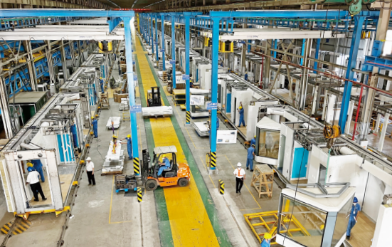

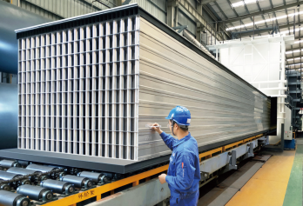
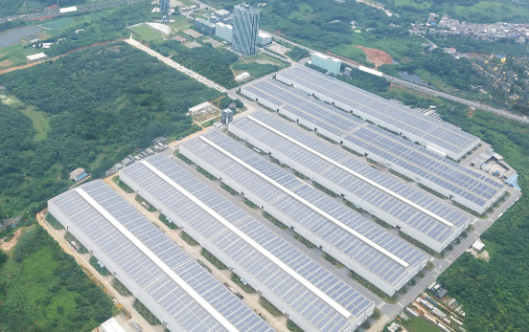
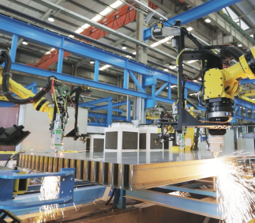
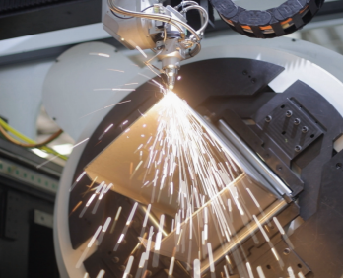
Only standardization can realize the mass and continuous production on the streamlined production
In 2022, BROAD Holon Co., Ltd. has built the first automatic streamlined production for Holon buildings with an annual yield of 2.7 million m² . The factory occupies an area of 50,000m² , adopts more than 100 robots and dozens of intelligent facilities. On average, 1000 workers can produce 10m² Holon building /day. The Holon building's construction efficiency is 30 +times higher than that of conventional buildings and quality defects are almost zero, which actualizes the aspiration of "the flag bearer of modern architecture" Le Corbusier 100 years ago: "to build a house with the same Ford car principle I bought"
BROAD plans to set up 37 streamlined production lines with global partners within 3 years to achieve an annual capacity of 100 million m² Holon buildings after summarizing the experience and lessons of the first line and optimizing the design
5
1 3 | 2 4
6
1. 1100°C hot air copper brazing of B-Core slabs
2. B-Core slabs out from the copper brazing oven
3. B-Core slab laser trimming and hole opening
4. Column & beam laser cutting & welding
5. Holon building general streamlined production
6. Holon manufacturing base is located in Xiangyin, Hunan, and occupies an area of 230,000m² .
Note: photos are real scenes of Holon buildings streamlined production
19 20

Slide 12
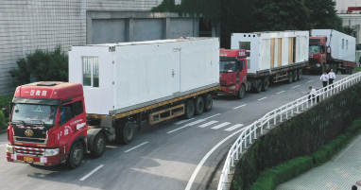
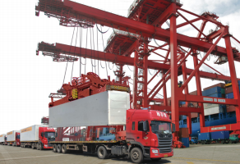
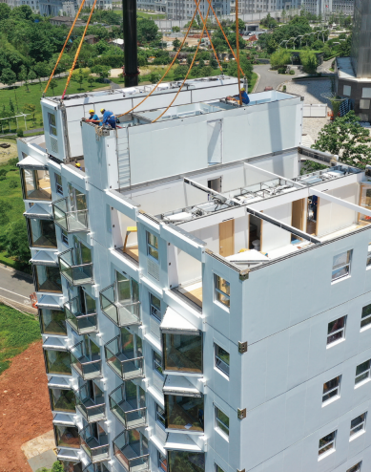
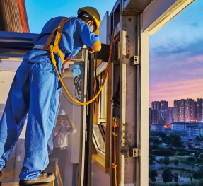
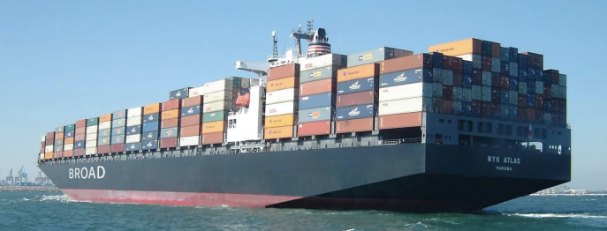
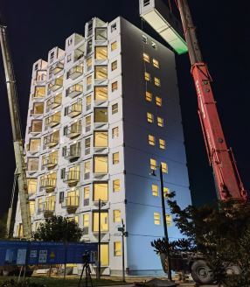
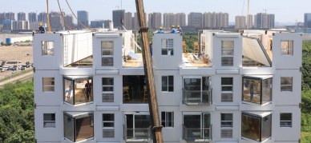
Only standardization can realize the barrier-free and low cost transportation worldwide
Only standardization can realize the high quality, high efficiency and low cost of installation
On-site installation is extremely simple
1. Structures are bolt screwed
2. Wall seams between B-Core slab connections are glued
3. Part interior walls are bolt screwed and glued
4. Connect utility hook-ups
Transport & Erection
No | Model | Height (m) | Area (m² ) | No. of trucks | Lifting Equipment | Fast Installation Crane Workers Days |  |  | Normal Installation Crane Workers Days
1 | A4.5-11 | 33 | 3000 | 58 | Tr uc k c ra ne 120t | 2 70 4 |  |  | 2 | 30 | 10
2 | A4.5-16 | 48 | 4400 | 83 | Tr uc k c ra ne 120t | 2 90 5 |  |  | 2 | 60 | 15
3 | A4.5-24-T3 | 72 | 19700 | 369 | Towe r c ra ne 14t | 6 | 250 | 7 | 3 | 120 | 20
4 | B9-24 | 72 | 12900 | 248 | Towe r c ra ne 14t | 4 | 200 | 7 | 2 | 60 | 23
5 | B9-32 | 96 | 17200 | 330 | Towe r c ra ne 14t | 4 | 200 | 9 | 2 | 60 | 28
6 | B9- 60 - O3 | 180 | 9700 | 1820 | Towe r c ra ne 14t | 8 | 400 25 |  | 6 | 120 | 80
Notes: 1. Transportation by 40ft standard container truck, train and vessel at 11t ~15t
2. The installation includes installation, commissioning & acceptance of structure, decoration, MEP, sanitary fittings, kitchen cupboard(kitchen cupboard is optional)
Notes: photos are real scenes of Holon building
21 22

Slide 13

Rated parameters, Material specifications, Technical standards
Building Rated Parameters
Adopted Standard
Main Material Specs
No | Items |  | Parameters |  |  |  |  | Notes
1 | Room module transport dimensions |  | L12,190 W2,438 H3,000 mm |  |  |  |  | Shipped as a standard 40ft container (actually no container is needed)
2 | Room module installation dimensions |  | L12,190 W4,876 H3,000 mm |  |  |  |  | The installation and transport dimensions for stair modules are the same
3 | Module transport weight |  | Room ≤ 15t, stair ≤ 11t |  |  |  |  | Stowage materials and tools are included
4 | Building floor height |  | 3 m |  |  |  |  | clear height 2.7m
5 | Structural material |  | Stainless steel (30 times more corrosion resistance than carbon steel) |  |  |  |  | Floor slabs are made of BROAD B-CORE slab while Columns and beams are section stainless steel
6 | Adapted standard |  | China, EU, US standards |  |  |  |  | Subject to the official approval from clients' country as the premise
7 | Life design |  | 1000-year structure |  |  |  |  | Other parts per EU Standards
8 | Insulation K-value |  | Rock wool in exterior wall 220 0.2 W / m² · K (Roof K-value=0.18 W / m² · K) |  |  |  |  | Rock wool insulation thickness will be increased in severe cold areas, K-value=0.14 W / m² ℃
9 | Window K-value |  | 4-paned large windows: 1.4 W / m² · K 3-paned small windows: 1.8W / m² · K |  |  |  |  | Additional insulation measures: exterior sunshade, interior thermal shade(if the interior thermal shade is used 50%, window K-value will be decreased by about 40%)
10 | Energy metering |  | Each household is seperate |  |  |  |  | Water, electricity, fresh air system and A/C consumption are calculated independently for each household
11 | Indoor temperature |  | Winter 22 ℃, Summer 24 ℃ |  |  |  |  | Occupants are able to adjust the temperature in each room
12 | Fresh air volume |  | 4m³ /m² ·h |  |  |  |  | CO₂ ≤900ppm
13 | Air freshness |  | 100% fresh air |  |  |  |  | No mixed return air (fresh air heat recovery rate 80%)
14 | Fresh air cleanliness |  | PM2.5 filtration efficiency 99.9% |  |  |  |  | Indoor air is 100 times cleaner than outdoor air
15 | Building energy consumption |  | Per the "Nearly Zero Energy Building Standard" 90% less energy consumption than that of traditional building |  |  |  |  | A/C & Fresh Air annual power consumption kWh/m² a: Severe cold area 12, cold area 12, hot summer and cold winter area 12, hot summer and warm winter area 14, warm area 4
16 | Standard delivery items |  | Turnkey project: including building construction, MEP, and decorations |  |  |  |  | Excluding foundation and other engineering works outside the building
Project Documents
No Name |  | Submission Deadline |  | BROAD | User | No | Name |  | Submission Deadline | BROAD | User
1 Purchase Order |  | P/O signing day |  | ▲ | ▲ | 19 | Building Modules packing Site Plan |  | 30 days before shipment | ○ | ▲
2 Architectural Drawing |  | P/O signing day |  | ▲ |  | 20 | Installation plan |  | 30 days before shipment | ▲ | ○
3 Technical Parameters Table |  | P/O signing day |  | ▲ |  | 21 | Foundation Acceptance Report |  | 30 days before shipment | ○ | ▲
4 Building Standard |  | P/O signing day |  | ▲ |  | 22 | Acceptance Report of Outside Roads, Water, and Electricity |  | 30 days before shipment | ○ | ▲
5 Comfort Standard |  | P/O signing day |  | ▲ |  | 23 | Installation Condition Confirmation Table |  | 30 days before shipment | ○ | ▲
6 Smart Control Specifications |  | P/O signing day |  | ▲ |  | 24 | Production Inspection Report |  | 2 days before shipment | ▲
7 Scope of After-Sales Responsibilities |  | P/O signing day |  | ▲ |  | 25 | Modules Stowage List |  | The day of shipment | ▲
8 Main materials list |  | P/O signing day |  | ▲ |  | 26 | Packing List |  | The day of shipment | ▲
9 Furnishings List |  | P/O signing day |  | ▲ |  | 27 | Delivery Checklist |  | 2 days after arrival | ○ | ▲
10 Mechanical & Electrical Devices List |  | P/O signing day |  | ▲ | ○ | 28 | Assembly Inspection Report |  | 7 days after installation | ▲
11 Structural Calculation Workbook |  | 20 days after the contract takes effect |  | ▲ | ○ | 29 | Indoor Air Quality Detection Report |  | 7 days after installation | ▲ | ○
12 Building Appearance Rendering |  | 20 days after the contract takes effect |  | ▲ | ○ | 30 | Construction Supervision Report (third party) |  | 7 days after installation |  | ▲
13 Foundation Plan |  | 20 days after the contract takes effect |  | ▲ | ○ | 31 | As-Built Drawing |  | 7 days after installation | ▲ | ○
14 Building Exterior Water and Electricity Supply Plan |  | 20 days after the contract takes effect |  | ▲ | ○ | 32 | Completion Acceptance Report |  | 7 days after installation | ▲ | ▲
15 Foundation Construction Drawing |  | 60 days after the contract takes effect |  | ○ | ▲ | 33 | Building Operation Guide |  | 7 days after installation | ▲
16 Construction Drawing of Exterior Roads, Water, and Electrici |  | 60 days after the contract takes effect |  | ○ | ▲ | 34 | Building Maintenance Technical Manual |  | 7 days after installation | ▲
17 Construction Permit (official) |  | 60 days before installation |  | ○ | ▲ | 35 | Supporting Equipment Maintenance Documents |  | 7 days after installation | ▲
18 Transport Plan |  | 30 days before shipment |  | ▲ | ○ | 36 | Official Approval Documents |  | 30 days after installation | ○ | ▲
China National Standards Name of the standard ・Technical standard of stainless steel core plate building structure ・Technical specification for stainless steel structures ・Load code for the design of buildings ・Code for seismic design of buildings ・Technical standard for assembled buildings with steel-structure ・Code for welding of steel structures ・Mechanical properties of fastenersstainless steel bolts, screws & studs ・High strength stainless structural steel for constructions ・Code for fire safety of steel structures in buildings ・Code of design on building fire protection and prevention ・Uniform standard for design of civil buildings ・Standard for electrical design of civil buildings ・Design code for heating ventilation and air conditioning of civil buildings ・Standard for design of building water supply and drainage ・Common Specifications of building energy efficiency and renewable energy utilization ・Technical standard for nearly zero energy buildings ・Design Standard for energy efficiency of residential buildings in severe cold and cold zones ・Double skin metal faced insulating panels for building ・Standard for acceptance of construction quality of steel structures ・Container inspection code Foreign Standards Name of the standard ・Specification for Structural Steel Buildings ・Seismic Provisions for Structural Steel Buildings ・Safety standard for fire testing of building structures and materials ・Structural Welding Code-Stainless Steel ・Fasteners for use in Structural Application ・Building Construction and Safety Code ・Safety Standard for fire resistance test in building adiabatic walls ・Limit States Design of Steel Structures (A National Standard of Canada) ・Eurocode 3: Design of steel structures. Part 1-2 ・Eurocode 8: Design of structures for earthquake resistance. Part 1 ・Execution of steel structures and aluminum structures. Part 2 ・Execution of steel structures and aluminum structures. Part 4 ・Fire classification of construction products and building elements. Part 1 ・Fire classification of construction products and building elements. Part 2 ・Building hardware-Gasket and weatherstripping for doors, windows, shutters and curtain walling.Part 1 ・Glass in building- Glazing and airborne sound insulation- Product descriptions and determination of properties ・Structural use of steelwork in building(British Srandard) ・Fire precautions in the design, construction and use of buildings. Part 5 ・Code of practice for fire safety in the design, management and use of buildings ・German Code for Steel Structures | Code of the standard T/CSUS 14-2021 CECS 410:2015 GB 50009-2012 GB 50011-2010 GB/T 51232-2016 GB 50661-2011 GB/T 3098.6-2014 GB/T 37430-2019 GB 51249-2017 GB 50016-2014 (2018 version) GB 50352-2019 GB 51348-2019 GB 50736-2012 GB 50015-2019 GB 55015-2021 GB/T 51350-2019 JGJ 26-2018 GB/T 23932-2009 GB 50205-2020 2021 version Code of the standard AISC 360-16 ANSI/AISC 341-16 ANSI/UL 263-2003 AWS D1.6 ANSI/ASME B18.2.6-2006 ANSI/NFPA 5000-2006 ANSI/UL 1040-2001 CAN/CSA-S16-09 EN 1993:2005 EN 1998-1:2004 EN 1090-2:2018 EN 1090-4:2018 EN 13501-1:2018 EN 13501-2:2016 EN 12365-1-2003 EN 12758-2002 BS 5950 BS 5588-5:2004 BS 9999-2008 DIN 18800
CAT | No Item Main Material Specification Note
Structure | 1 2 | column beam | S32001 S32001 | C360x180/C360x360 x6、8、10、12、16 wall thick:4, 6, 8, 10, 12 | wall thickness of columns and beams is determined by structure calculation BXG1000 applies for super high-rise
 | 3 | floor | panel:QN1804, core tube 304 rock wool 120kg/m³ | A1.5 L:11380 W: 2 m / 2.6 m | BROAD B-CORE slab plate δ 1.5\ core tube Φ 51 x 0.4
 | 4 | ceiling frame | SUS201 | □20x20x0.7/1.5
 | 5 | balcony | floor : 304 guardrail:SUS201 | 2446x1490 □80x40x2、□40x20x1.5 □20x20x1.7
Wall | 1 | fire layer | calcium silicate board rockwool 120kg/m³ | δ9+δ9 δ50 | for column & beams
 | 2 | exterior wall | galvalume steel plate rockwool 120kg/m³ | exterior δ0.7, interior δ0.4 δ220 | PVDF paint (UV-Proof) hydrophobic
 | 3 | interior wall | galvalume steel plate, magnesium oxide board rockwool 120kg/m³ | δ0.4，δ5 δ75，δ50 | PE Paint hydrophobic
Door & Window | 1 | balcony window | Frame: QN1701 interior:3-paned tempered glass exterior:tempered ultra clear glass | □100x100x1.5 ultra clear glass (1380x2088x36) 1380x2176x8 | interior: filling with polyurethane; exterior: extruded board for insulation, δ 25 6+9Ar+6+9Ar+6
 | 2 | bay window | top and bottom panel:galvalume steel plate frame: QN1701 interior:4-paned tempered glass exterior:tempered ultra clear glass | δ0.7 □80x40x2 ultra clear glass (1380x1630x36) 1455x1788x8 | 6+9Ar+6+9Ar+6
 | 3 4 5 | small window casement window balcony glass door | window frame: aluminum alloy frame of broken bridge glass: 3-paned tempered insulating glass | 776x500, 5+9Ar+5+9Ar+5 935x1000, 5+9Ar+5+9Ar+5 860x2185, 5+9Ar+5+19Ar+5 | 70 series fluorocarbon powder ultra clear glass
 | 6 | door & window frame | galvalume steel plate | δ0.4 | PE Paint
 | 7 | window frame | bamboo | δ9 | class E0、E 1
 | 8 | exterior shade | aluminum alloy shades | slice width 25 | wireless & smart control, motor noise ＜30dB
 | 9 | interior shade | multi-cavity honeycomb curtain aluminum foil on the back (shading 99.5% or higher) | THK:50
 | 10 11 | entrance door stair door | steel, PE paint | 1050x2390 | class B fire resistant
 | 12 | room door | aluminium frame door, UV paint | 910x2055 | class E0 /E1
 | 13 | bath door | aluminum alloy, ground glass | 700x2100 | folding door, class E0 /E1
Pipes | 1 | air duct | Double-sided aluminum foil, phenolic board, galvalume steel plate | δ10、δ0.8 | FR B1
 | 2 | water supply pipes | S30408 | φ8×0.8, φ16×0.8 φ20×1.0, φ25×1.0 φ32×1.2, φ50.8×1.2 φ76×1.5, φ101.6×2 | water pressure test 4Mpa
 | 3 | drainage pipes | PVC-U | dn20、dn32、dn50、 dn75、dn110、dn160 | water pressure test 0.1Mpa Incl. sewage, waste & rain water
CAT | No Item Main Material Specification Note
Electrics | 1 | electric cables | plastic wrapped copper wires | RV0.5~RV6, YJV, BVR, WDZN | fire cables are fire resistant
 | 2 | telecom cables |  | RVS, RVV, AWG24×5/3/2
 | 3 | netcables |  | CAT6
 | 4 | optical fiber | fiber glass | butterfly dual-core fiber | LSHF cable
 | 5 | light switch | PVC cover | wireless
 | 6 | lights | LED | color TEMP 3100±100k | luminous efficiency ≥ 150 lm/W
 | 7 | socket | PVC cover | 10A、16A | 5 or 3 hole
Equipment | 1 | lift | steel, aluminum | load: 1050kg | kone or equivalent
 | 2 | fresh air | various materials | 260m³/h | BROAD
 | 3 | A/C | steel, cooper, Al | 3.5kW | first-class brand
 | 4 | electric boiler | steel, EPP | 100L
 | 5 | range hood | SS | 3 levels of air flow
 | 6 | R0 water purifier | various materials | 50 gallons
Finishing | 1 | room floor | bamboo floor | δ10 | class E0、E 1
 | 2 | toilet floor | PVC plastic floor | δ3 | anti-skip grade Ad、Aw
 | 3 | baseboard | aluminum alloy | 60×10
 | 4 | ceiling | Galvalume steel plate | δ37
 | 5 | stair surface finish | ceramic tile | δ10
Sanitary wares | 1 | lavatory sink | sintered stone slab/quartz ceramic basin faucet SUS304 bamboo cabinet, damp-proof board ultra-clear silver coated mirror mirror cabinet: paint-free plate | δ10 410×295 155×150 δ12~18 520×900 440×760 | no scratch from hard object Easy to clean / lass E 0,E1 tempered class E0,E1
 | 2 | toilet | ceramics, PP board | 700x380x700 | 3L / 5L 2 gears
 | 3 | bathtub | acrylic/SMC | 1660x750x570 | wear-resistant, easy to clean
 | 4 | shower basin | acrylic/SMC | H: 190
 | 5 | shower head | abs chroming | φ80 | /
 | 6 | faucet | SUS304 | with drainage diverter | water efficiency Level 2
 | 7 | towel rack | SUS304 | / | same for toilet paper holder
 | 8 | mirror | ultra-clear silver coated mirror | δ5 | /
Kitchen ware | 1 | cabinet | damp proof board | / | class E0,E1
 | 2 | table slab | quartz | δ15 | wear-resistant, easy to clean
 | 3 | kitchen sink | stainless steel | drawing the single slot | /
 | 4 | faucet | stainless steel | pull-type | 2-level
Public parts | 1 | stairwell | B-CORE slab:304DL filling rock wool | A1.5 | B-CORE Slab plate δ1.5, tubeΦ51x0.4
 | 2 | stairs | QN1701 | stepping δ2.5 side plate δ6 | /
 | 3 | stair rail | SUS201 | □40x20x1.5, □20x0.7 | white matte
 | 4 | rooftop | QN1701, S32001, galvalume steel plate, anti-slip & super white laminated tempered glass | δ4, δ2.5, δ12, δ0.7
 | 5 | guardrail | SUS201 | □20x20/40、40x80 | QN1701：δ6、δ1
Model Overview
Note: Single room can be used as hotel, condo, dormitory
Building Model | Floor area/F | No. | Name | Floor area/ apartment | Bathroom | Max bedrooms | Suitable residents | Dining room | Apartments/F | Building | Combined building
A 4.5 | 273m² 21942x12190 | 1 2 3 4 5 | Plate single room Plate double room Plate-type S apt Plate-type M apt Penthouse | 23m² 47m² 68m² 137m² 273m² | 1 1 1 2 4 | 1 1 2 4 8 | 1 1 1 2 | 1 2 | 12 6 4 2 1 | 16F | 56F
A 6.5 | 394m² 31694x12190 | 6 7 | Wide plate apartment Plate duplex apartment | 196m² 392m² | 4 8 | 4 8 | 1 1 | 1 1 | 2 1 | 16F | 56F
B 9 | 538m² 23980x21942 | 8 9 10 11 | tower single room tower double room tower S apt tower M apt | 22~35m² 36~54m² 59~69m² 130~136m² | 1 1 1 2 | 1 1 2 4 | 1 1 1 | 1 | 20 12 8 4 | 32F | 80F
B 13 | 777m² 23980x31694 | 12 13 | Wide tower apartment tower duplex apartment | 190~196m² 380~392m² | 4 8 | 4 8 | 1 2 | 1 2 | 4 2 | 32F | 80F
23 24

Slide 14
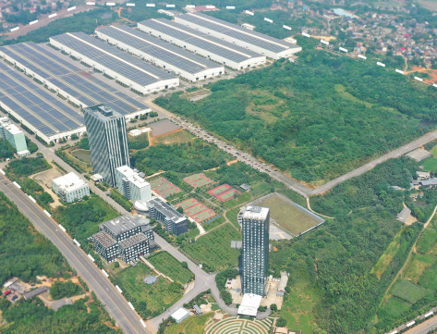
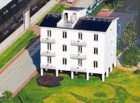
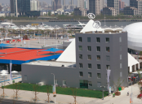

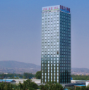
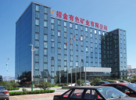
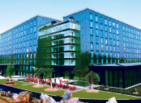
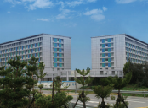
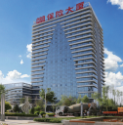
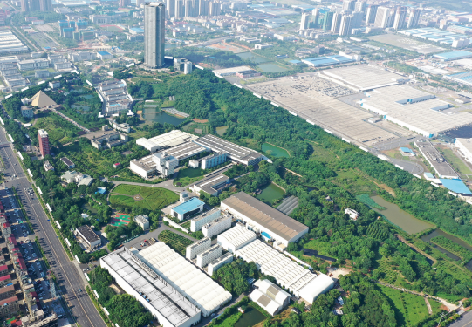

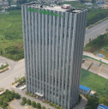
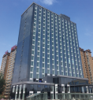
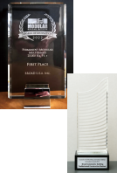
An introduction to
BROAD Group and BROAD Holon Co., Ltd.
Brief History of BROAD Factory-made buildings
· In 2009, BROAD developed the factory- made steel-structured building, achieving a construction speed
of three storeys per day
· In 2010, BROAD built a 6-storey BROAD Pavilion at Expo Shanghai within one day
· In 2015, BROAD built a 57-storey complex in just 19 days
· BROAD built 58 factory- made buildings in 6 years, achieving the sustainable goal of Magnitude 9
earthquake resistance, 5 times higher energy efficiency, and indoor air quality 100 times cleaner than outdoor air
· In 2018, BROAD developed the stainless steel B-CORE slab, replacing carbon steel with stainless steel
and halting production of carbon steel structure buildings
· In 2020, BROAD successfully developed factory- made stainless steel building- Holon Building
BROAD Gr oup is a priv a t ely - owned enterprise founded in 1988 in China with RMB 30,000. The company has developed hundreds of hi-tech products and has never copied any technology of its peers since inception . The mission of BROAD Group is "For Humanity's Future: the original low carbon & durable technology for the earth, the original clean and safe technology for humans. " Headquartered in Changsha, BROAD Group has exported products to over 80 countries. BROAD wholly owns 12 subsidiaries, including Broad Air Conditioning Co., Ltd., BROAD Clean Air Technology Co., Ltd., BROAD Sustainable Building Co., Ltd., BROAD Holon Co., Ltd., etc
BROAD Holon Co., Ltd . was established in 2009, its factor y is located at BSB Town, Xiangyin, Hunan. Workshops cover 230,000m², with over 1000 employees
BSB Town
BROAD Pavilion at Expo 2010 built in 1 day • Shanghai A condo building completed in 3 days • Hubei |  |  | COP16 Cancun BROAD Pavilion built in 1 day (Mexican President cut the ribbon) • Mexico Cultural & Innovation Center built in 3 days • Fujian
 |  |  | At the World Modular Building Institute's Annual 2022 in US, on April 28, 2022 China's BROAD Group won the first prize "Awards of Distinction" in the Multifamily 25,000+ sq.ft. category from 141 candidates, the first time a Chinese company has won the award. Medal： Council on Tall Buildings and Urban Habitat Innovation Award 2013 BROAD Sustainable Building Prefabricated Construction Method On April 27, 2022, BORAD Holon Building won the Innovation Award 2022 awarded by Council on Tall Buildings and Urban Habitat, the first time a Chinese company has won the awards
 |  | Hotel built in 7 days (the 58th building) • Shaanxi
Urban complex built in 19 days • Hunan | Hotel built in 8 days • Hunan
Residence (the first one) built in 1 day • BROAD Town in Hunan
A complex building built in 13 days • Shanxi
A corporate HQ built in 4 days • Shandong
Office building built in 9 days • Ningxia
BROAD Town
25 26

